Slide 1
IBM HR Analytics Employee Attrition & Performance Analysis
dataset – IBM HR Analytics Employee Attrition & Performance Analysis
source – Github Repository
Name: B GAMYA SRI
Email: beherasrigamya@gmail.com
Phone: 91-6309328271
Linkedin: linkedin.com/in/gamyabehara/
Github: github.com/GamyaBehara

Slide 2
INTRODUCTION
This project presents an analytical overview of employee data from the IBM HR Analytics dataset, focusing on:
Patterns behind employee attrition
Departmental and job role trends
Salary and age distributions
Work-life balance and satisfaction metrics
Performance-related insights
Key factors influencing retention
GAMYA BEHARA

Slide 3
ANALYSIS OF THE DATASET
The IBM HR Analytics Employee Attrition & Performance dataset is a fictional dataset created by IBM data scientists to study factors influencing employee attrition (turnover). It helps analyze patterns related to workforce demographics, compensation, satisfaction, and performance to uncover key drivers behind why employees leave an organization.
1. Dataset Details:
Total Records: 1,470 employees
Features: 35 attributes covering personal, professional, and satisfaction metrics
Target Variable: Attrition (Yes/No)
Source: IBM HR Analytics Employee Attrition & Performance Analysis
GAMYA BEHARA

Slide 4
ANALYSIS OF THE DATASET
2. Dataset Structure & Quality
The dataset contains 1,470 rows and 35 columns
Each employee is uniquely identified by the EmployeeNumber attribute.
Data types are well-defined — numerical, categorical, no missing/ null and well structured.
Well-suited for statistical analysis, visualization, and predictive modeling.
3. Key Attribute Categories:
Demographic: Age, Gender, MaritalStatus, Education
Work-Related: Department, JobRole, JobLevel, YearsAtCompany
Compensation: MonthlyIncome, PercentSalaryHike, StockOptionLevel
Satisfaction & Engagement: JobSatisfaction, WorkLifeBalance, EnvironmentSatisfaction
Performance Indicators: OverTime, YearsSinceLastPromotion, TrainingTimesLastYear
GAMYA BEHARA

Slide 5
ANALYSIS OF THE DATASET
4. Descriptive Insights:
Age Range: 18 to 60 years, with the majority of employees in the 30–39 age group.
Departments: Three main departments — Sales, Research & Development, and Human Resources.
Attrition Rate: Approximately 16% of employees have left the company.
OverTime: Nearly 30% of employees work overtime; higher attrition observed among them.
5. Analysis Conducted:
Calculated average attrition rate by Department and visualized with bar plots.
Compared Gender-based attrition using pie charts.
Analyzed the impact of OverTime on attrition with bar charts.
Examined attrition trends by IncomeBand using bar plots.
Assessed the influence of JobSatisfaction levels on attrition using bar charts.
GAMYA BEHARA

Slide 6
ANALYSIS OF THE DATASET
6. Relationships analysis
Department vs. Attrition – Identified departments with the highest attrition percentages
Gender × Attrition – Compared attrition trends across male and female employees
OverTime × Attrition – Assessed the impact of extra working hours on employee turnover
IncomeBand × Attrition – Studied how salary levels relate to attrition rates
Promotion × Attrition – Explored the relationship between promotion gaps and attrition
AgeGroup × Attrition – Analyzed how age affects likelihood of leaving
JobSatisfaction × Attrition – Examined how satisfaction levels relate to attrition
JobRole × OverTime × Attrition – Combined role and overtime to identify which job roles, when coupled with overtime, have higher attrition
Multiple Factors × Attrition – Combined key attributes (Department, OverTime, Income, Promotion Gap, Age, JobSatisfaction) to analyze their collective impact on attrition
GAMYA BEHARA

Slide 7
ANALYSIS OF THE DATASET
7. Final demographics
Younger employees (<30 years) show higher attrition
Mid-career employees (30–39 years) have moderate attrition
Employees above 40 show lower attrition
Job satisfaction affects retention across all age groups
Sales department exhibits the highest attrition.
Employees working OverTime are more likely to leave.
Lower-paid employees have higher attrition.
Low job satisfaction strongly correlates with attrition.
GAMYA BEHARA

Slide 8
WORKFLOW OF THE PROJECT- STRUCTURE
Since this project is built using PySpark, the analysis workflow was structured as follows:
Data Loading: Imported the dataset into PySpark and created a Spark DataFrame.
Preprocessing: Added a numeric column for Attrition (Yes=1, No=0) to facilitate calculation of attrition rates.
Attrition Analysis: Computed attrition rates for each factor using groupBy and average.
Visualization: Converted results to Pandas DataFrames and created annotated plots using Matplotlib and Seaborn.
Interpretation: Titles and annotations on plots highlight the main reasons behind high attrition for each factor.
Now let us see the attrition levels in different factors:
GAMYA BEHARA

Slide 9
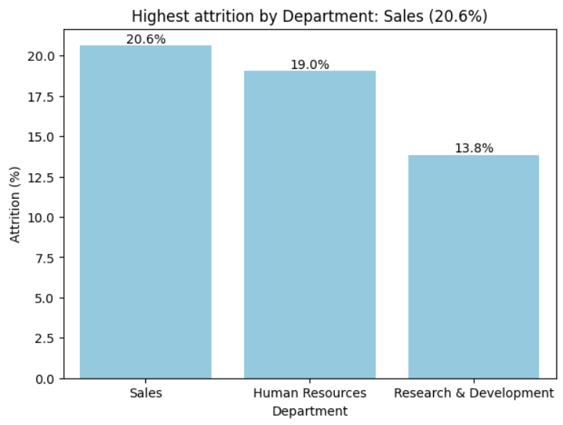
Attrition – Department Level
Attrition – Department wise :
Sales:
highest attrition rate, greater turnover of employees Human Resources (HR):
moderate attrition, relatively stable retention.
Research & Development (R&D):
lowest attrition, employee satisfaction
Insight: Retention efforts should focus primarily on the Sales department, possibly by improving incentives or reducing stress-related workload
GAMYA BEHARA

Slide 10
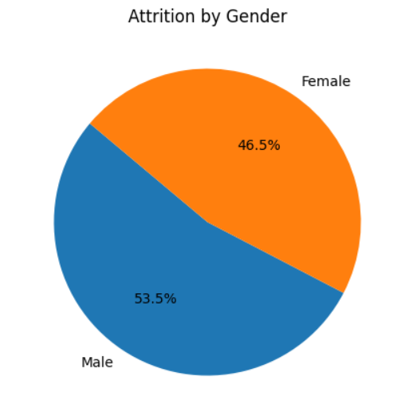
Attrition – Gender Comparison
Attrition – Gender Comparison
Both genders experience attrition, but male employees show a slightly higher attrition rate than females
This could be due to differences in job roles, workload, or external opportunities pursued more by male employees.
Insight: Gender doesn’t drastically impact attrition, but balanced engagement initiatives and flexible policies may improve retention for both.
GAMYA BEHARA

Slide 11
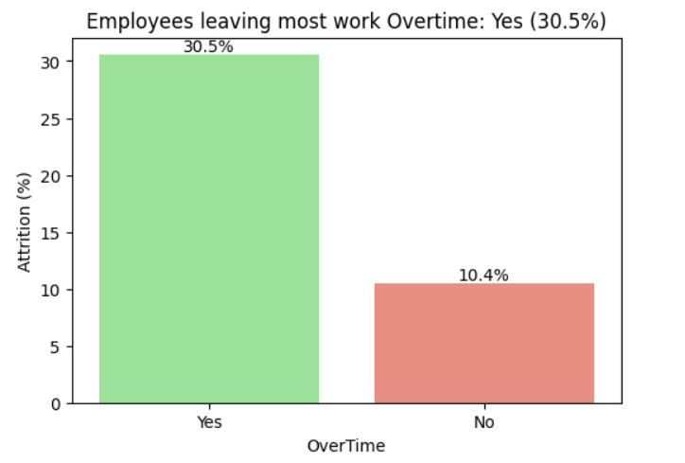
Attrition – Overtime Impact
Attrition – Overtime Impact
Employees who work overtime have a significantly higher attrition rate compared to those who do not.
Continuous overtime likely leads to burnout, lower satisfaction, and eventual turnover.
Insight: Overworking correlates strongly with employee exits — organizations should monitor overtime frequency and encourage work-life balance.
GAMYA BEHARA

Slide 12
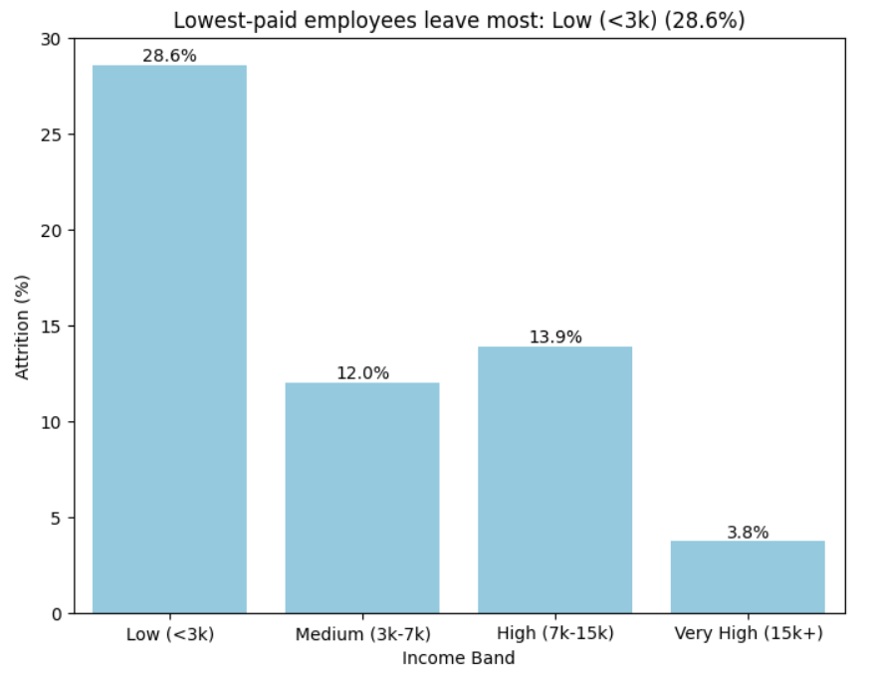
Attrition – Income Band
Attrition – Income Band
Lower income bands show much higher attrition, while higher income employees tend to stay longer
This indicates that salary and financial incentives are major retention factors
Insight: Competitive compensation and growth opportunities are crucial to reduce attrition among lower-income employees..
GAMYA BEHARA

Slide 13
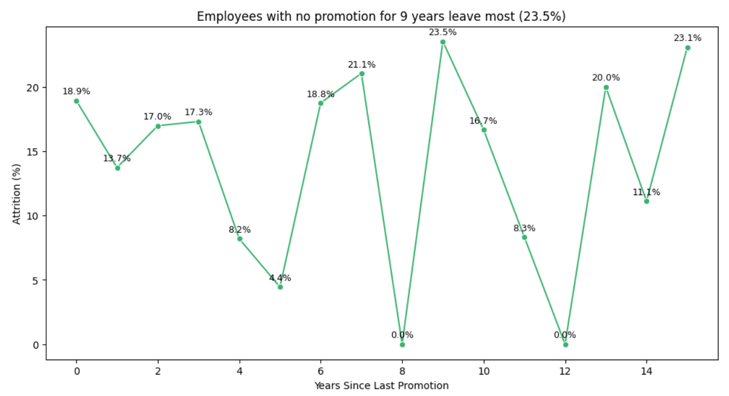
Attrition – Promotion Gap
Attrition – Promotion Gap
Employees with longer durations since their last promotion exhibit higher attrition rates
Those promoted recently are more engaged and less likely to leave.
Insight: Career progression and timely recognition significantly influence retention — regular reviews and growth paths can help reduce turnover.
GAMYA BEHARA

Slide 14
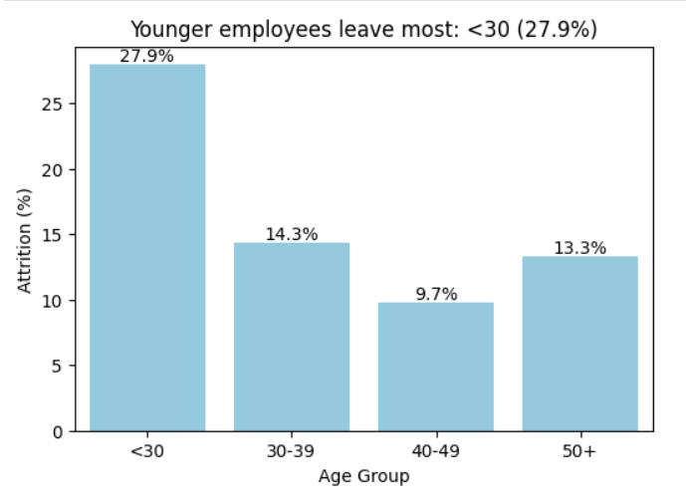
Attrition – Age Group
Attrition – Age Group
Younger employees (<30 years) show the highest attrition, suggesting early-career mobility or dissatisfaction.
Older employees (40+) have lower attrition, likely due to stability, loyalty, or satisfaction with their role
Insight: Younger staff need targeted retention strategies — mentorship, learning programs, and early growth opportunities.
GAMYA BEHARA

Slide 15
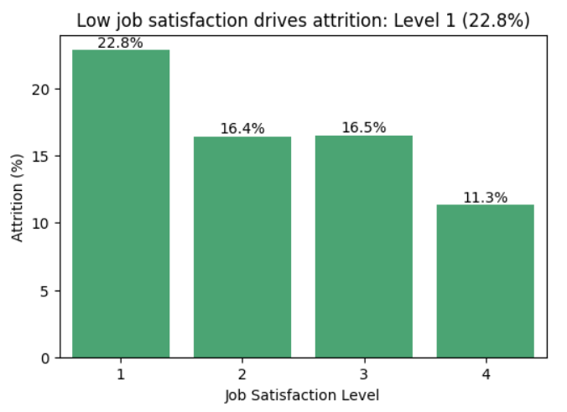
Attrition – Job Satisfaction
Attrition – Job Satisfaction
Employees with low job satisfaction show a significantly higher attrition rate compared to those who are more satisfied with their jobs
Insight: Improving job satisfaction through regular feedback, career development programs, and recognition initiatives can greatly reduce attrition and enhance employee retention.
GAMYA BEHARA

Slide 16
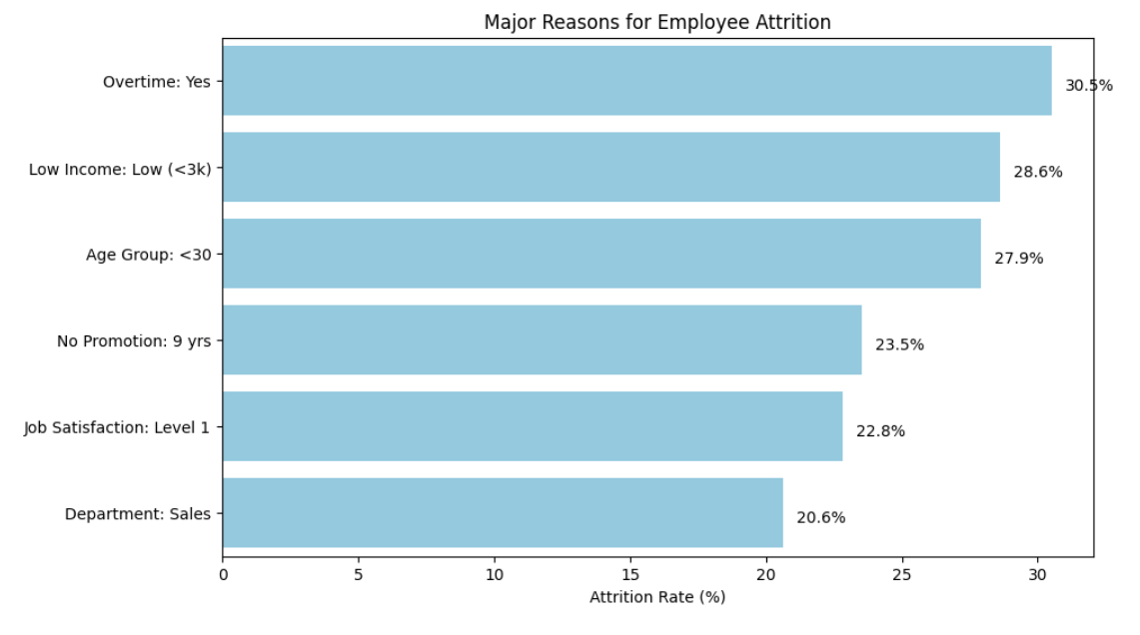
Major factors responsible for Attrition
Factors Responsible for Attrition
Various employee attributes contribute to attrition within the organization.
Among them, excessive overtime combined with low income are key factors driving employee turnover.
GAMYA BEHARA

Slide 17
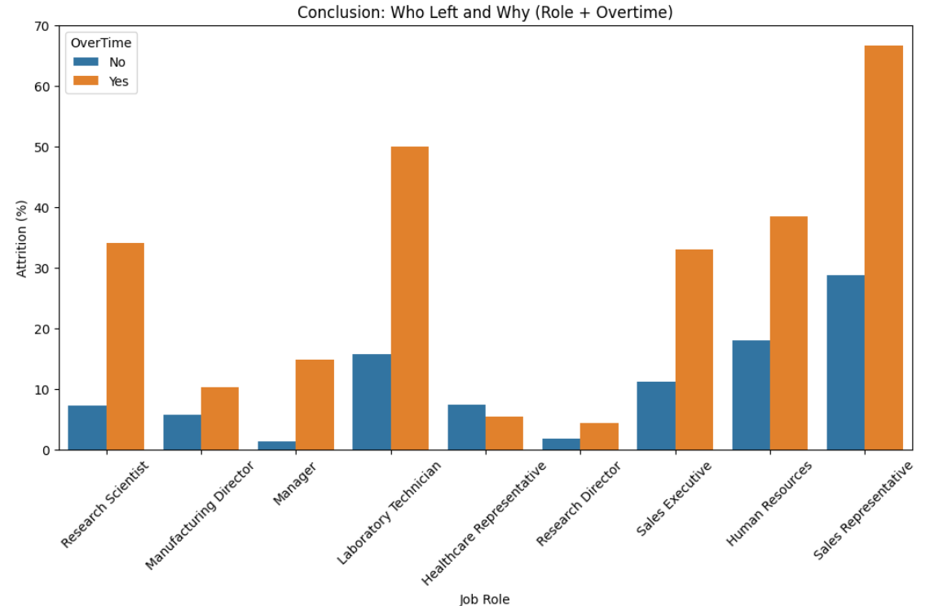
Attrition – Who left due to Overtime?
Sales representatives experience high attrition mainly due to long working hours and frequent overtime demands
More factors:
Low income levels and limited incentives
Work stress and inadequate financial rewards
GAMYA BEHARA

Slide 18
OBSERVATION
The analysis reveals that employee attrition in the organization is primarily influenced by factors such as overtime, low income, lack of promotions, and low job satisfaction. Departments like Sales experience the highest turnover, especially among younger employees and those earning lower salaries.
Excessive workload and inadequate financial or career growth opportunities lead to reduced engagement and higher resignation rates. On the other hand, employees with better compensation, work-life balance, and satisfaction tend to remain longer with the company.
To minimize attrition, organizations should focus on fair compensation, timely promotions, balanced workloads, and initiatives that enhance employee satisfaction and well-being.
GAMYA BEHARA

Slide 19
CONCLUSION
The analysis of IBM HR Analytics data revealed key factors driving employee attrition, including age, Sales department, overtime, low pay, and limited promotions. Insights from this study can help HR design targeted retention programs, improve compensation and career growth strategies, and enhance employee engagement. Future predictive models and dashboards can further support proactive workforce management and reduce turnover.
GAMYA BEHARA

